Slide 1

Counters and Registers

Slide 2

Counter
A special type of sequential circuit used to count the pulse is known as a counter, or a collection of flip flops where the clock signal is applied is known as counters.
The counter is one of the widest applications of the flip flop. Based on the clock pulse, the output of the counter contains a predefined state. The number of the pulse can be counted using the output of the counter.

Slide 3
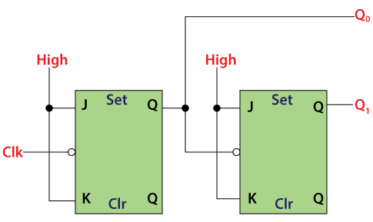
Types of counters
Asynchronous or ripple counters: The Asynchronous counter is also known as the ripple counter. Below is a diagram of the 2-bit Asynchronous counter in which we used two T flip-flops. Apart from the T flip flop, we can also use the JK flip flop by setting both of the inputs to 1 permanently. The external clock pass to the clock input of the first flip flop, i.e., FF-A and its output, i.e., is passed to clock input of the next flip flop, i.e., FF-B.

Slide 4
Synchronous Counter: Unlike the asynchronous counter, synchronous counter has one global clock which drives each flip flop so output changes in parallel. The one advantage of synchronous counter over asynchronous counter is, it can operate on higher frequency than asynchronous counter as it does not have cumulative delay because of same clock is given to each flip flop. It is also called as parallel counter.

Slide 5
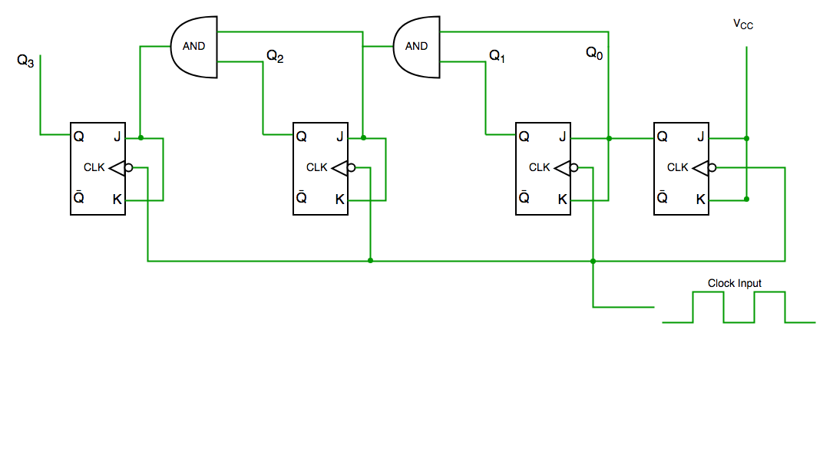

Slide 6
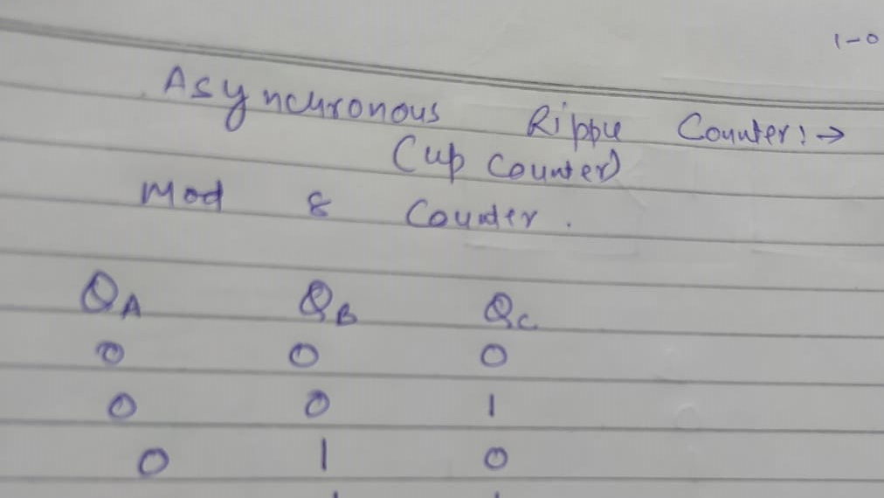

Slide 7
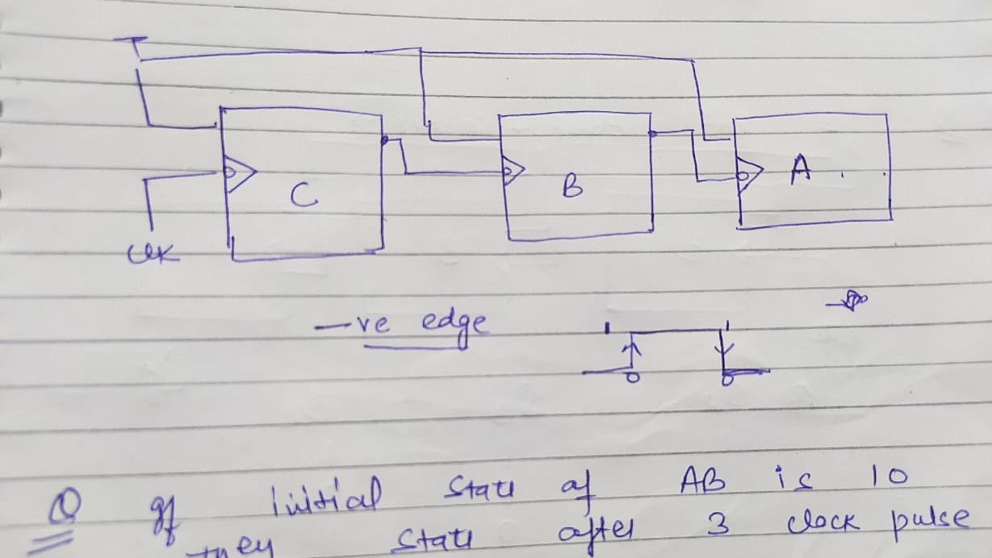

Slide 8
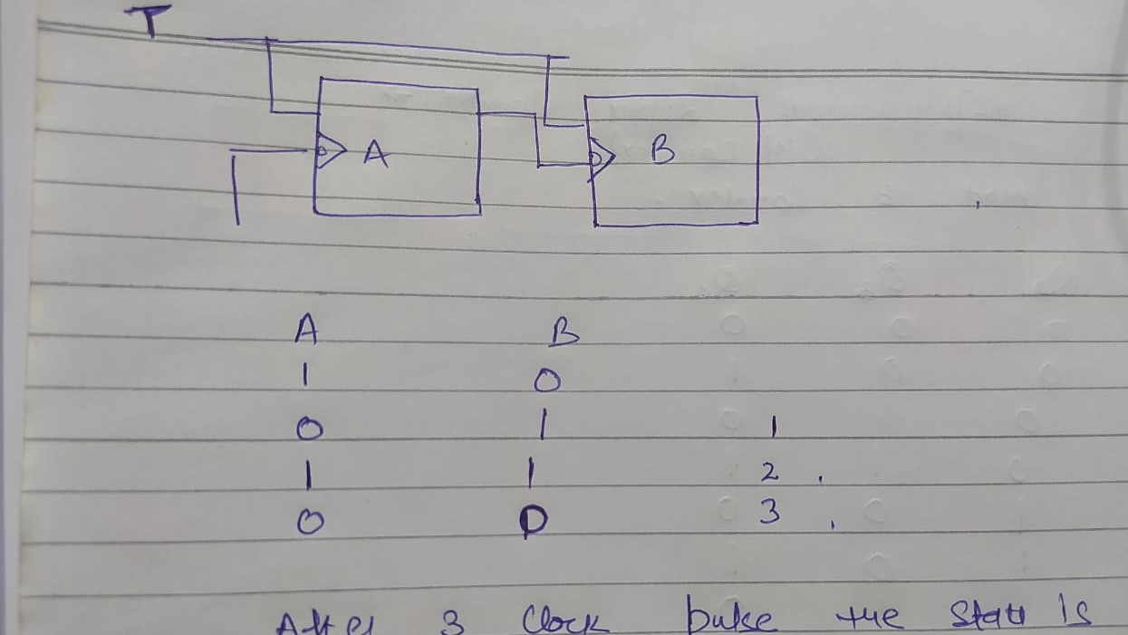

Slide 9
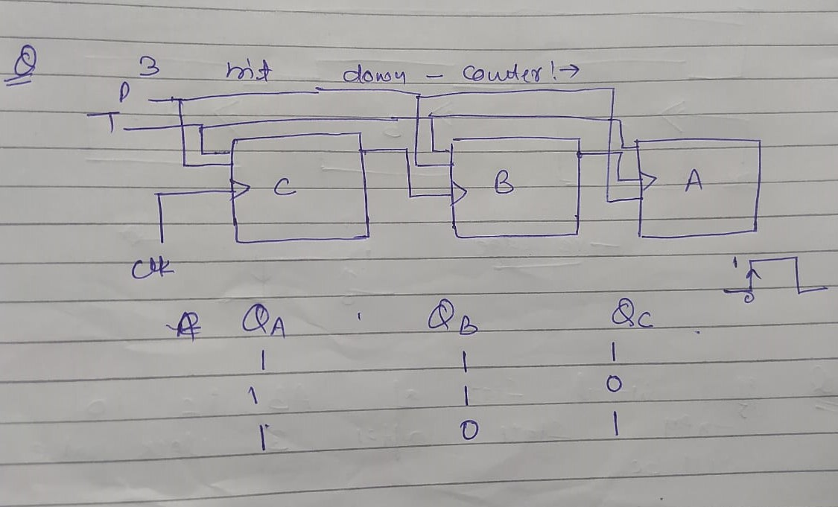

Slide 10
Registers
A Register is a collection of flip flops. A flip flop is used to store single bit digital data. For storing a large number of bits, the storage capacity is increased by grouping more than one flip flops. If we want to store an n-bit word, we have to use an n-bit register containing n number of flip flops.
The binary data in a register can be moved within the register from one flip-flop to another. The registers that allow such data transfers are called as shift registers. There are four mode of operations of a shift register.

Slide 11
Types
Serial Input Serial Output
Serial Input Parallel Output
Parallel Input Serial Output
Parallel Input Parallel Output

Slide 12
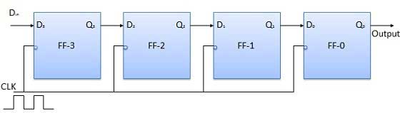
Serial Input Serial Output

Slide 13
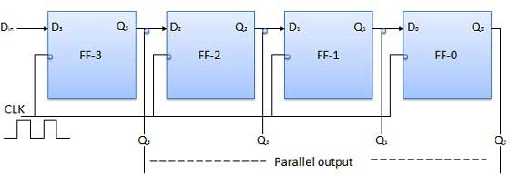
Serial Input Parallel Output

Slide 14
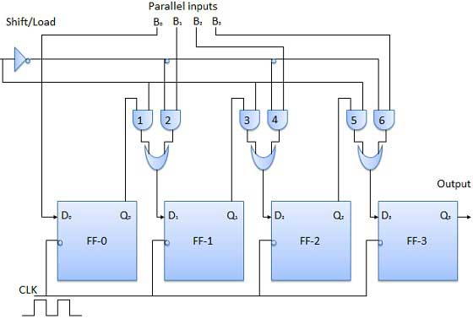
Parallel Input Serial Output

Slide 15
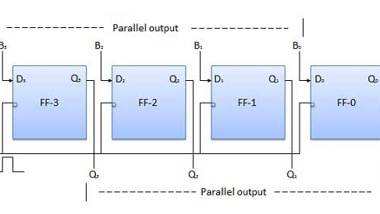
Parallel Input Parallel Output

